Slide 1
COMS 4111: Introduction to Databases Lecture 14: Midpoint Course Evaluation, Database Systems Implementation (II): Disks (continued)
Indexes
Dr. Donald F. Ferguson
dff9@columbia.edu

Slide 2
Contents

Slide 3
Contents
Student mid-semester course evaluation
Summary.
Comments.
Actions.
HW 3 Piazza questions.
Conceptual data model.
Semester/year/date.
Generated columns.
Database systems implementation
Hard disk drive basics.

Slide 4
Midterm Course Evaluations

Slide 5
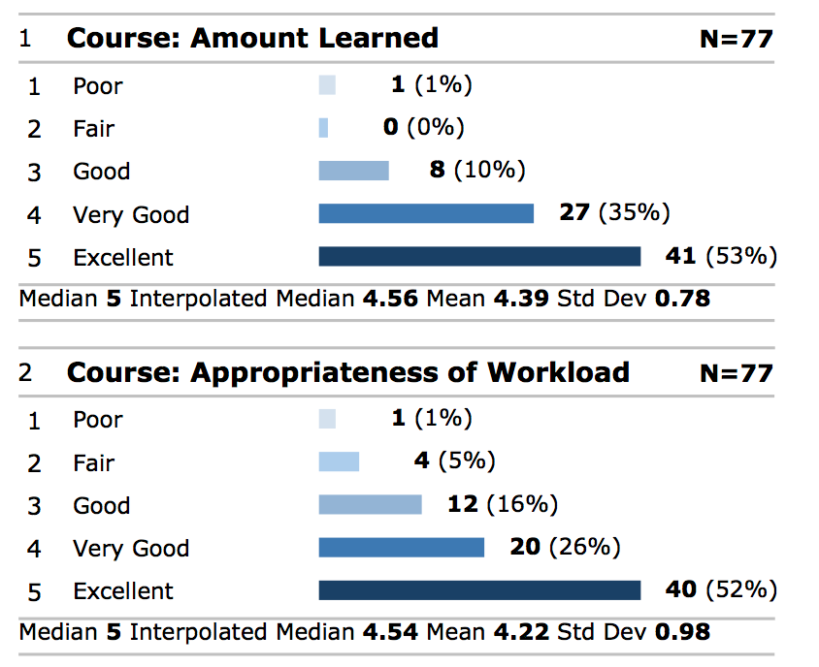
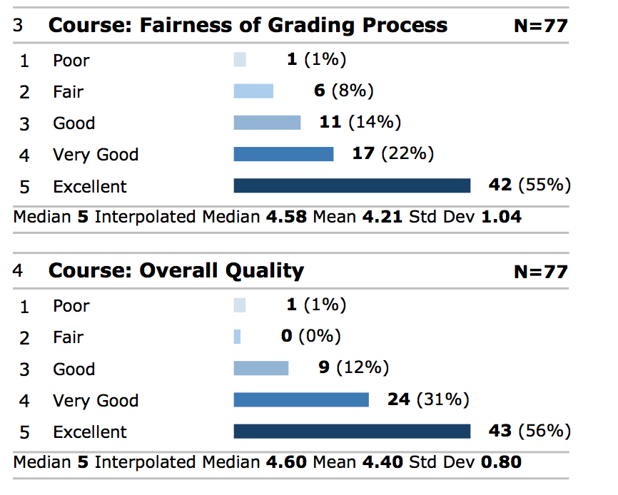
Summary – Course
Note: These numbers are before midterm.

Slide 6
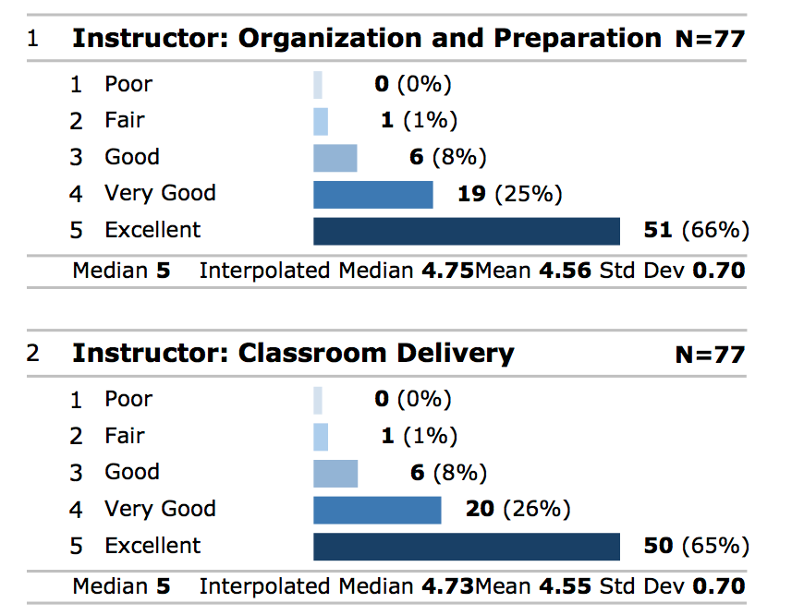
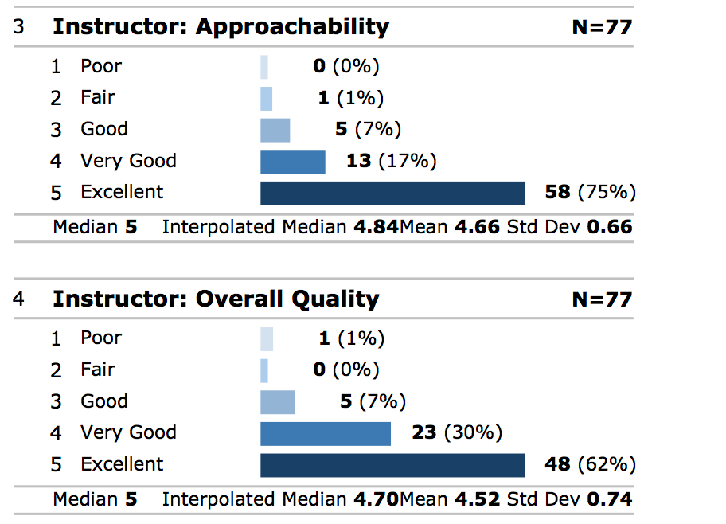
Summary – Instructor
Note: These numbers are before midterm.

Slide 7
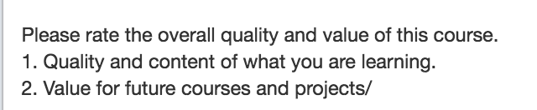
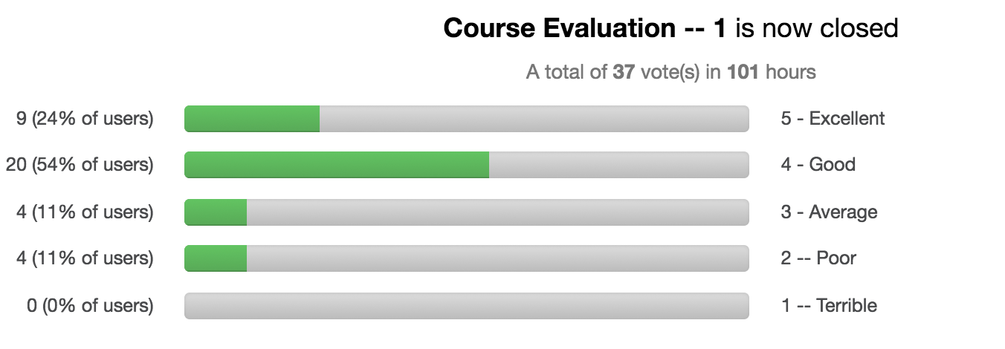
Piazza Poll
Poll started after
midterm.
Mean is 3.92

Slide 8
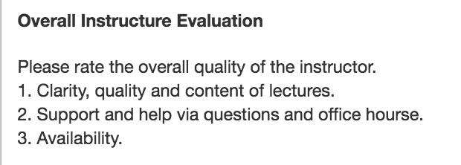
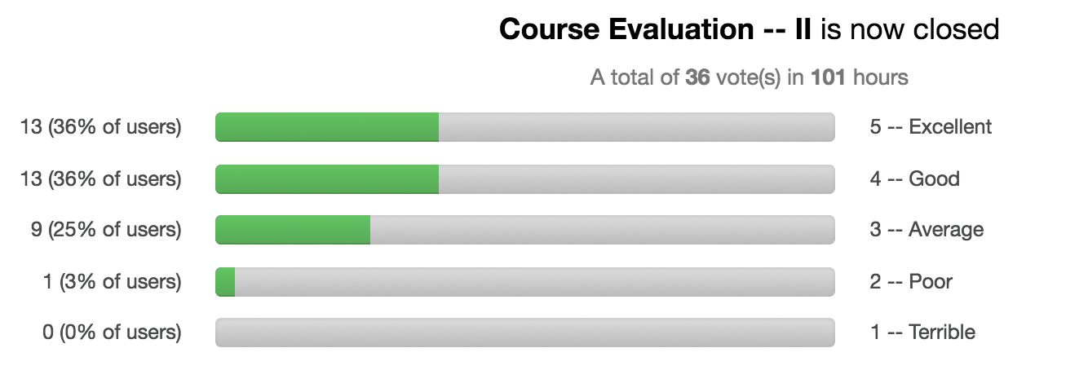
Piazza Poll
Poll started after
midterm.
Mean is 4.05

Slide 9
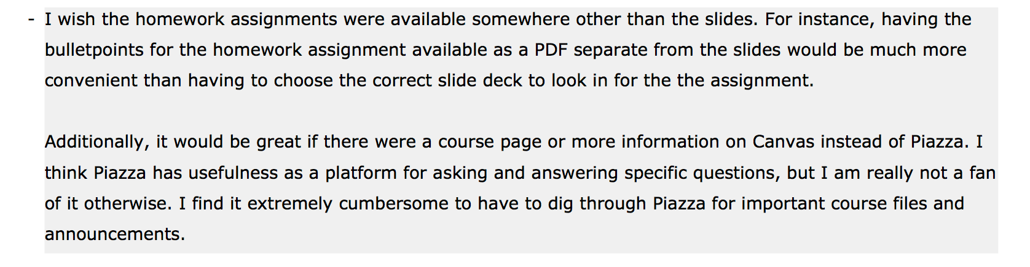
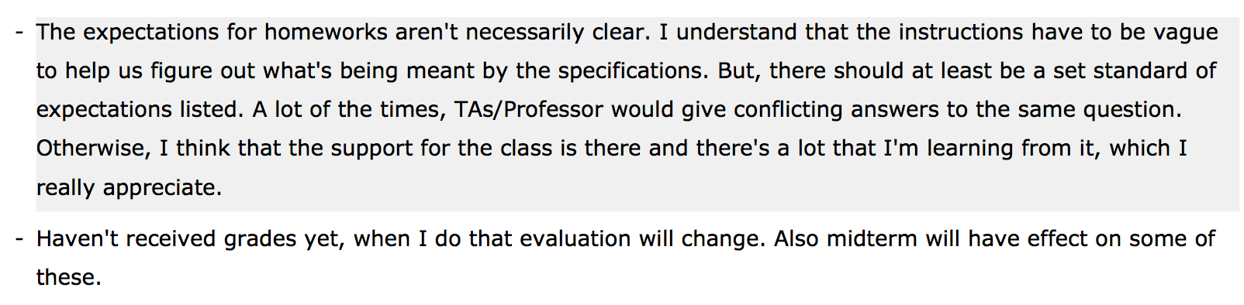
Selected Comments
Easy fix.
Easy fix.

Slide 10
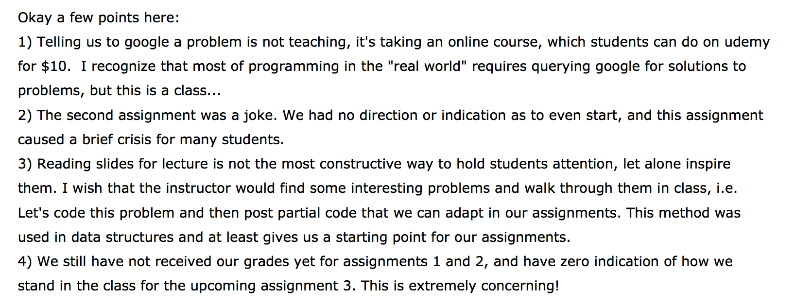
Selected Comments

Slide 11
Actions
Vague homework
I had an objective by vague homework specifications.
You will eventually have to solve vaguely specified problems with the technology.
But, the new technology and a new way of thinking is clearly overwhelming you.
Will switch to more clearly defined HW assignments. See https://courseworks2.columbia.edu/courses/47468/assignments/116699 for an example. Feedback is welcome.
Inconsistent answers between TAs and professor.
Some of this is inevitable. There are many possible solutions to problems.
Less vague homework will reduce inconsistency.
You will not be penalized if you follow a TAs guidance.
Lectures will attempt to start with a motivating problem and then progressively show how to apply concepts.
Udemy comment:
I have probably commented more than 100 times on Piazza and hold office hours. I answered 27 HW3 questions on Thursday, Friday, Saturday and Sunday (so far).
What do you think I do when I am not sure what error code xxx means or I cannot remember the exact syntax of some complex query?

Slide 12
Leadership

Slide 13

My Mousepad when Answering HW3 Questions
Project
Idea
Inside

Slide 14

Another Perspective
My brother is also a CS executive, but then again … He is my brother and may also be confusing or vague.

Slide 15
HW 3 Questions

Slide 16
Piazza Questions

Slide 17
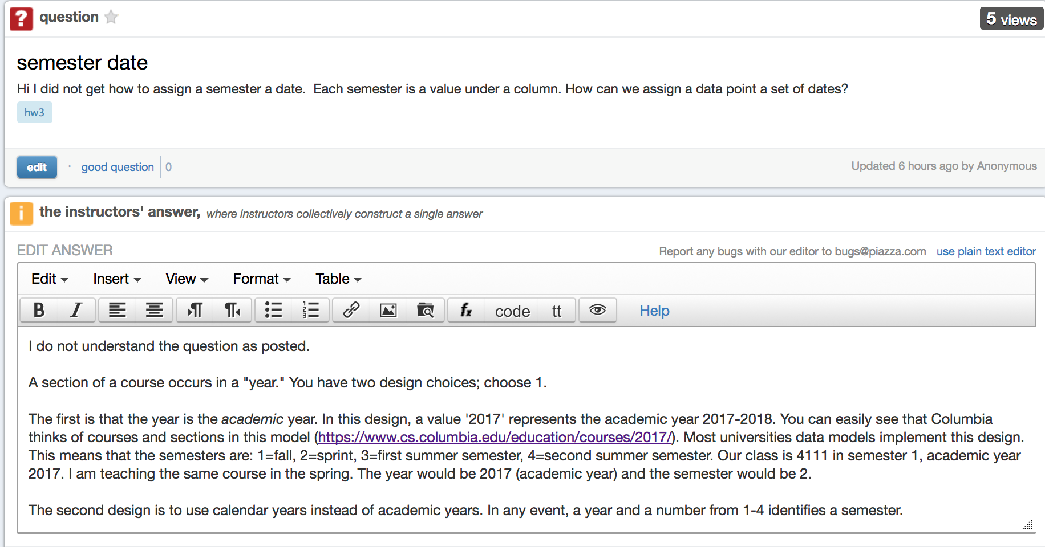
Year and Semester

Slide 18
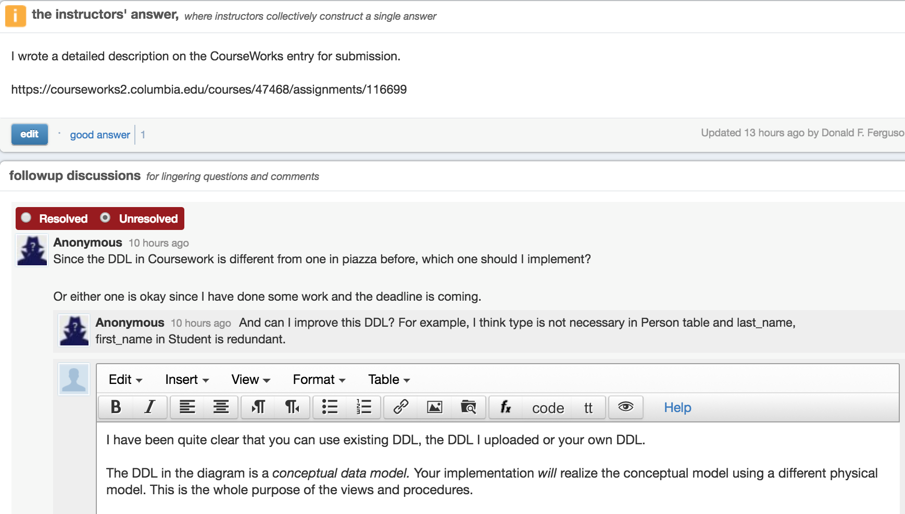
HW 3 – DDL

Slide 19
Those Whacky Generated Columns

Slide 20
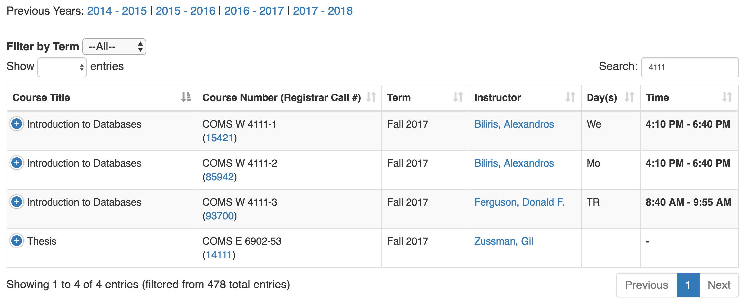

Slide 21
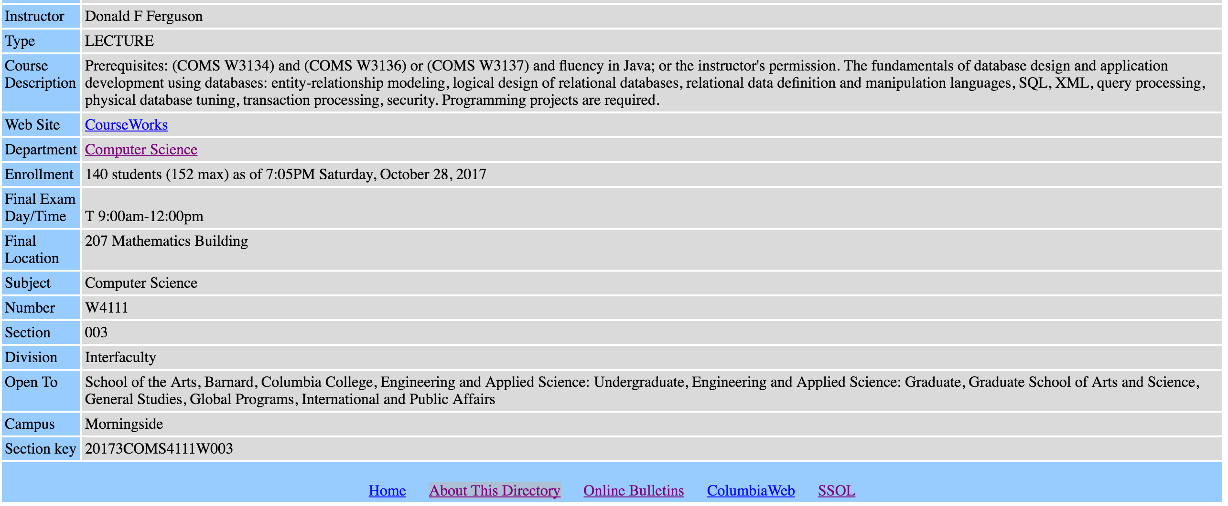

Slide 22
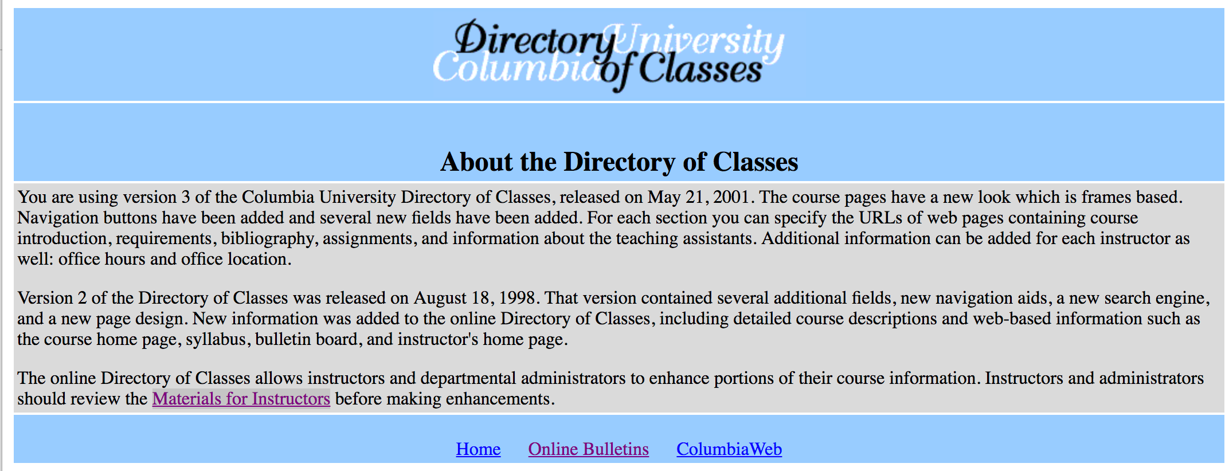

Slide 23
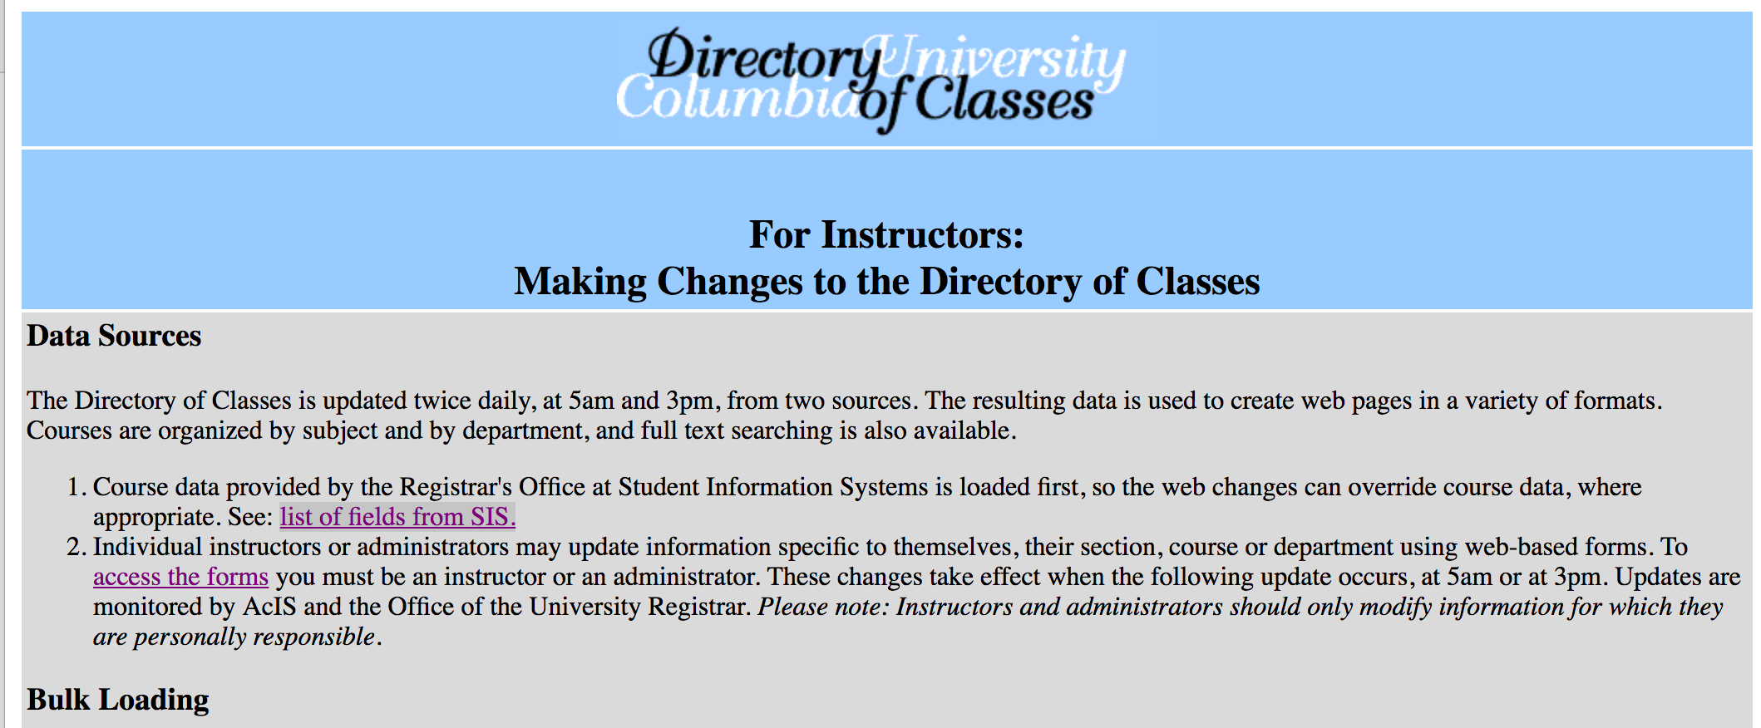

Slide 24
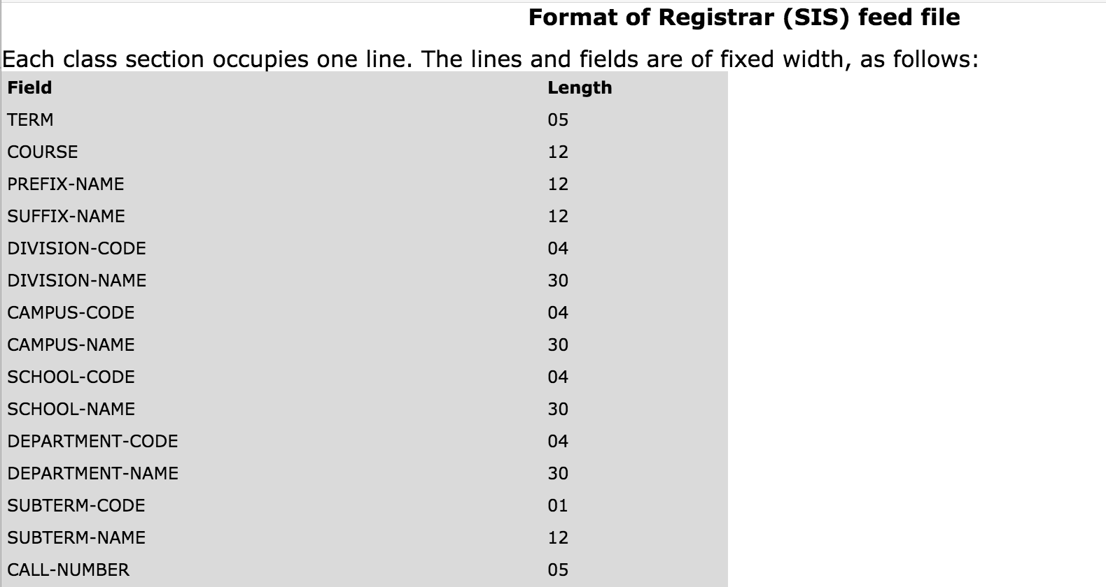
Someone went through how the university operates courses, sections, semesters, …
And figured out this data model.

Slide 25
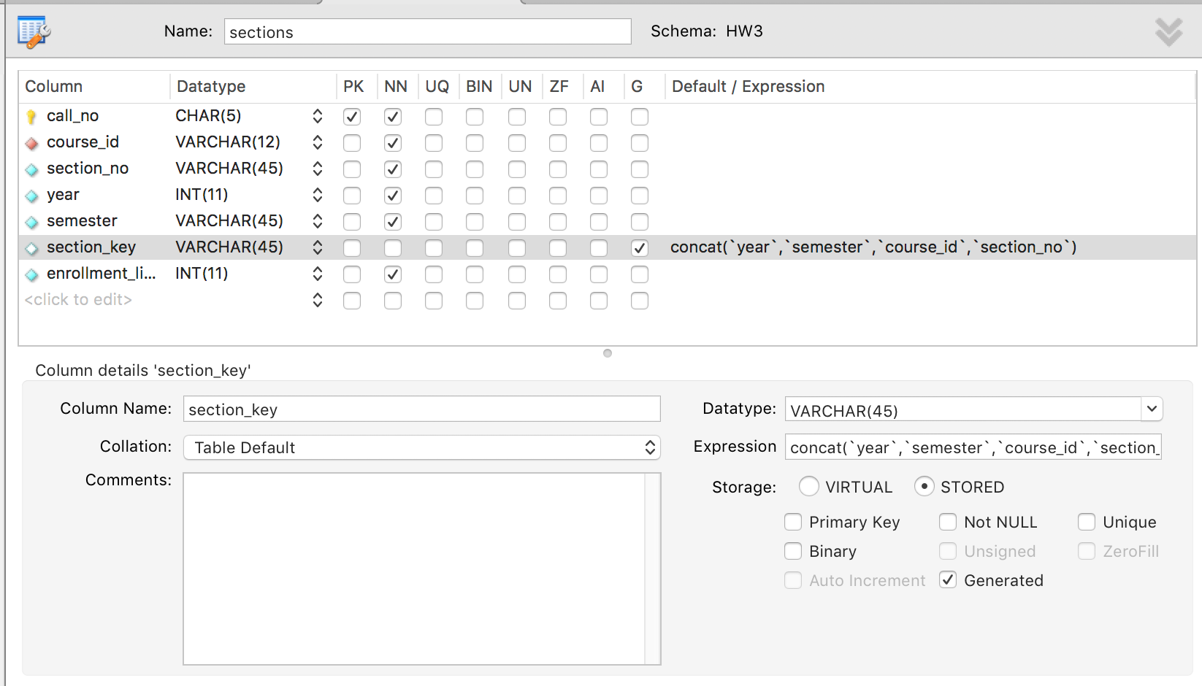
Sections

Slide 26
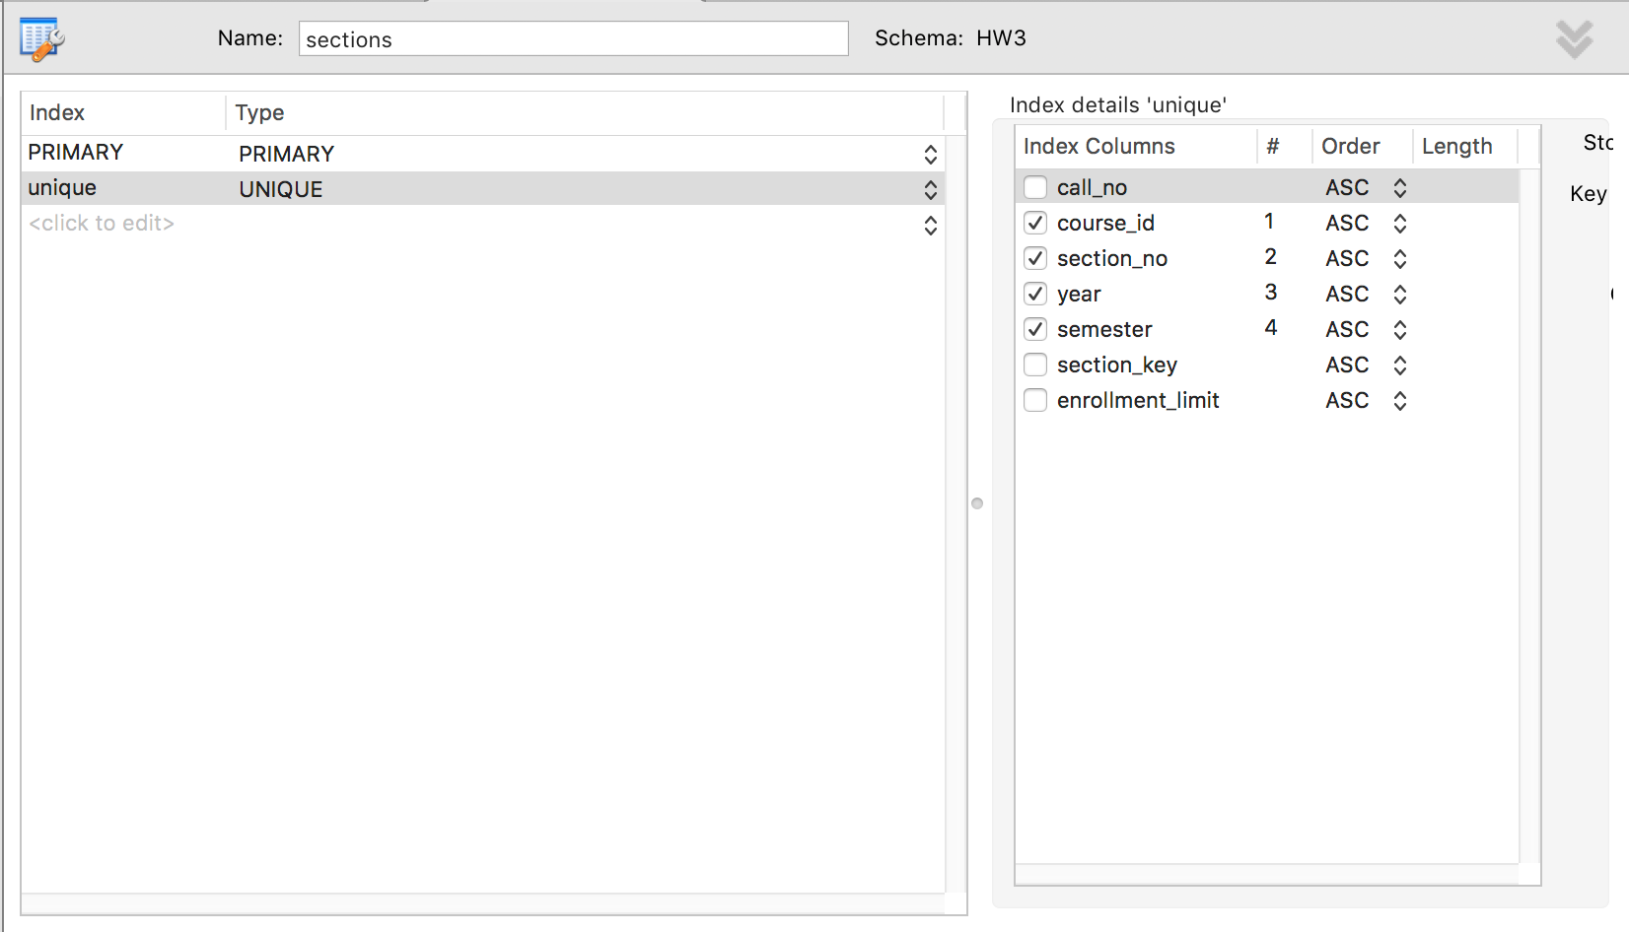
What Defines a Section ID?

Slide 27
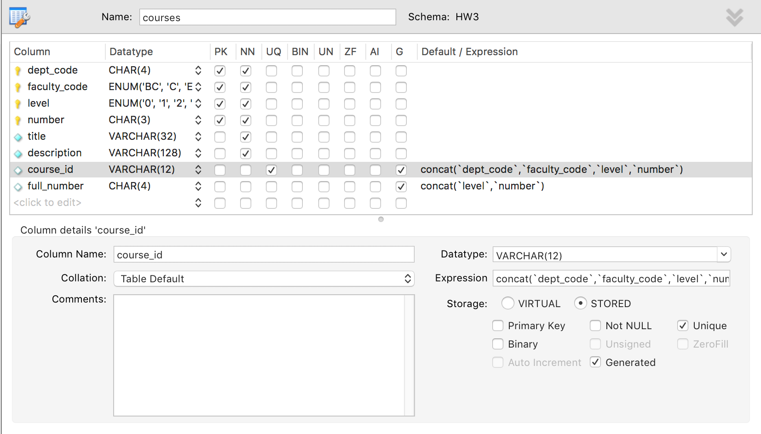
Depends on What Defines a Course ID

Slide 28
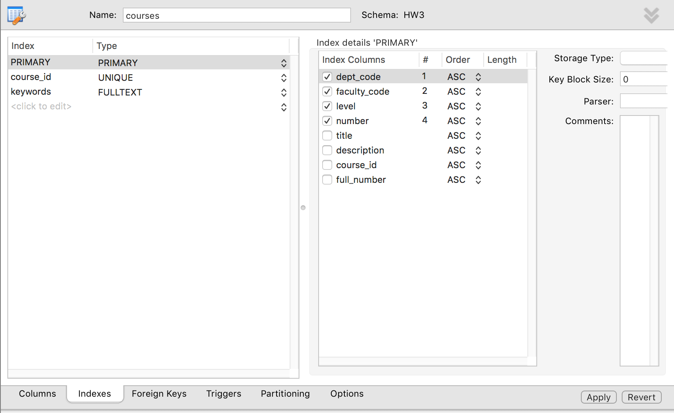
Course ID

Slide 29
Course ID
If I
Decompose COMSW4111 into
Dept.
Faculty.
Level.
Number.
I can ensure data integrity by applying constraints to individual fields, e.g.
Level is ENUM('0', '1', '2', '3', '4', '6', '8', '9')
Faculty is ENUM('BC', 'C', 'E', 'F', 'G', 'V', 'W', 'X')
Dept. is in the Departments table.
A 4xxx course cannot have a prereq on a 6xxx course.
The stored, generated column
Is indexable, AND
Allows me to build apps with URLS like …/columbia/courses/coms4111
Without the application code, outside of the DB, understanding how to form simple course IDs from the various fields.

Slide 30
Still, My DDL is not Good
Section_no is not 45 characters.
Year is not -2147483648
etc.
Efficient storage management is a key value of DBMS.
CREATE TABLE `sections` ( `call_no` char(5) NOT NULL, `course_id` varchar(12) NOT NULL, `section_no` varchar(45) NOT NULL, `year` int(11) NOT NULL, `semester` varchar(45) NOT NULL, `section_key` varchar(45) GENERATED ALWAYS AS (concat(`year`,`semester`,`course_id`,`section_no`)) STORED, `enrollment_limit` int(11) NOT NULL, PRIMARY KEY (`call_no`), UNIQUE KEY `unique` (`course_id`,`section_no`,`year`,`semester`), CONSTRAINT `section_course_fk` FOREIGN KEY (`course_id`) REFERENCES `courses` (`course_id`) ON DELETE NO ACTION ON UPDATE NO ACTION ) ENGINE=InnoDB DEFAULT CHARSET=utf8

Slide 31
Database Management System Implementation

Slide 32
Reminder

Slide 33
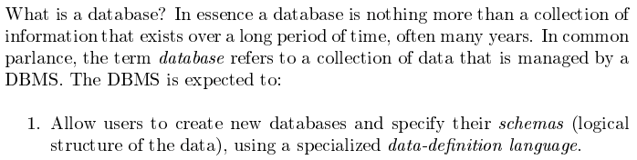
Database Management System (Lecture 1)
Covered for the relational model.
Database Systems: The Complete Book (2nd Edition) by Hector Garcia-Molina (Author), Jeffrey D. Ullman (Author), Jennifer Widom (Author)

Slide 34
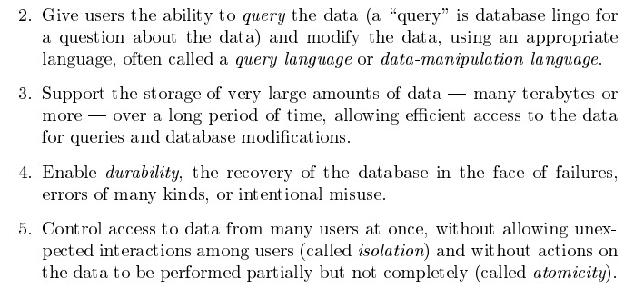
Database Management System
Focus for next part of course.
Database Systems: The Complete Book (2nd Edition) by Hector Garcia-Molina (Author), Jeffrey D. Ullman (Author), Jennifer Widom (Author)

Slide 35
Very Large Amounts of Data

Slide 36
Disks as far as the eye can see.

Slide 37
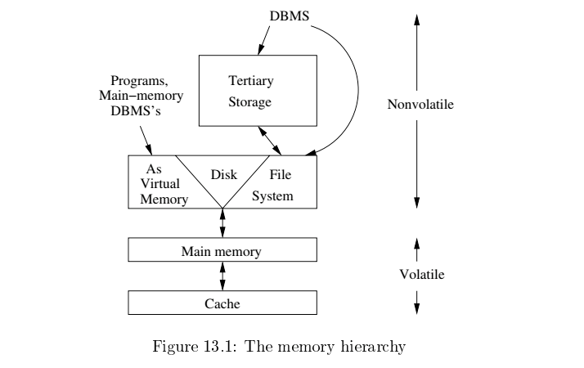
Memory Hierarchy
Slower
Cheaper
Unlimited
Faster
More expensive
Limited

Slide 38
Memory Hierarchy
Slower
Cheaper
Unlimited
Think about your laptops. Mine has
8 MB cache
16 GB RAM
516 GB disk drive
Not to mention terabytes of on backup drives, cloud, …
Same concepts apply in large scale environments, although specific technology at each tier may be different.
Faster
More expensive
Limited

Slide 39
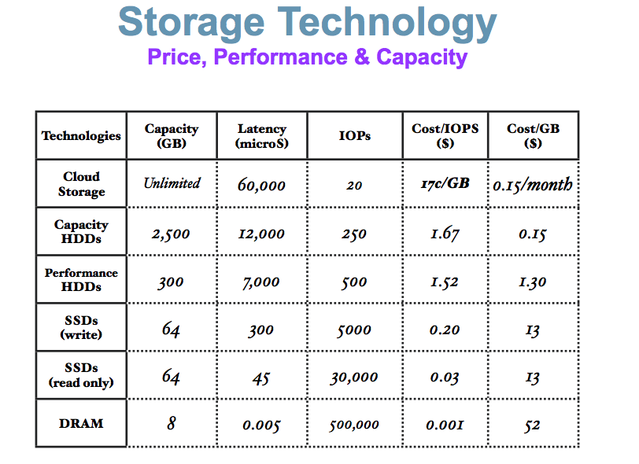
(Very Old) Comparison
These numbers are ancient.
Looking for more modern numbers.
But, does give an idea of
Price
Performance
The general observation is that
Performance goes up 10X/level.
Price goes up 10x per level.
Note: One major change is improved price performance of SDD relative to HDD for large data.

Slide 40
Another Perspective

Slide 41
Managing and Using Large Amounts of Data

Slide 42

Database Management System
Find things quickly.
Access things quickly.
Load/save things quickly.
Store things efficiently.
Database Systems: The Complete Book (2nd Edition) by Hector Garcia-Molina (Author), Jeffrey D. Ullman (Author), Jennifer Widom (Author)

Slide 43
Storage Management (I)

Slide 44
Disk Behavior and Optimization

Slide 45
Hard Disk Drive

Slide 46
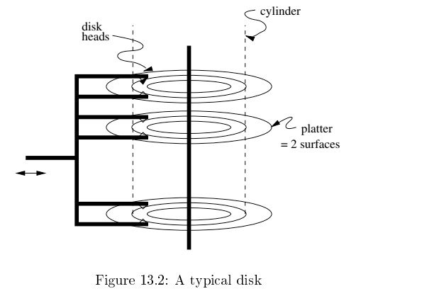
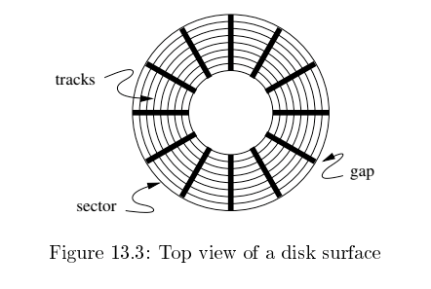
Disk Configuration
Components of disk I/O delay
Seek: Move head to cylinder/track.
Rotation: Wait for sector to get under head.
Transfer: Move data from disk to memory.
Database Systems: The Complete Book (2nd Edition) by Hector Garcia-Molina (Author), Jeffrey D. Ullman (Author), Jennifer Widom (Author)

Slide 47
Implications
I grew up in a tiny town in a very rural area.
The ”stores” were very far away and spread out.
If we were out of milk and we needed a cup of milk, we
Bought all the milk we would need for a while
AND
Anything else we needed or might need that was in the store area.
Disk I/O is the same way
Getting a block is as cheap as getting a byte.
Try to optimize your travel time by planning your trip.

Slide 48
Data Access Patterns
Think about accessing tuples in a database. The access patterns are not completely random. For example,
SELECT … ORDER BY … ➔ I look for things in sequence.
SELECT … WHERE last_name=“Smith” ➔ I look for sets of things.
CREATE VIEW AS SELECT … FROM JOIN … ON A.x=B.y ➔ I look for things in pairs of sets.
Optimizing I/O performance
Group records into blocks if accessed together.
Group blocks onto the same sector/cylinder if accessed together/sequentially ➔ Eliminates seek time.
Schedule access:
If I have to read cylinders 1, 9, 2, 8, 3
A better ordering is 1,2,3,9,8.
Stripe across disks: Read one block from 10 disks instead one 10 from 1.
Pre-fetch and preload.

Slide 49
Disk Scheduling
An example – Elevator Algorithm
Assume
The seek time from track n to m is ABS(n-m).
The I/O request queue is for sectors on tracks 1, 9, 2, 8, 3.
The head is currently on track 5.
Total seek time for FIFO processing
Seek order is 5→1→9→2→8→3
Total seek time is ABS(5-1) + ABS(1-9) + ABS(9-2) + ABS(2-8) + ABS(8-3) = 30
If the head goes all the way up and all the way down, like an elevator,
The seek order 5→8→9→3→2→1
Total seek time is ABS(5-8) + ABS(8-9) + ABS(9-3) + ABS(3-2) + ABS(2-1) = 12
There is a rich body of research and algorithms on optimizing
Blocks on tracks/sectors.
Seek/rotation optimization.

Slide 50
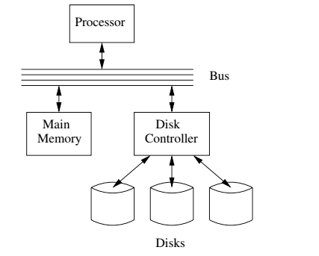
I/O Architecture
Large scale environments
The bus-controller connection is over some kind of network.
The disk controller is at the disks, and basically a “computer” with SW.
Network is either
Standard communication network, or
Highly optimized I/O network.
How we normally think of disks and I/O.

Slide 51
Solid State Disk
Hard
Disk
Drive
Solid
State
Drive

Slide 52
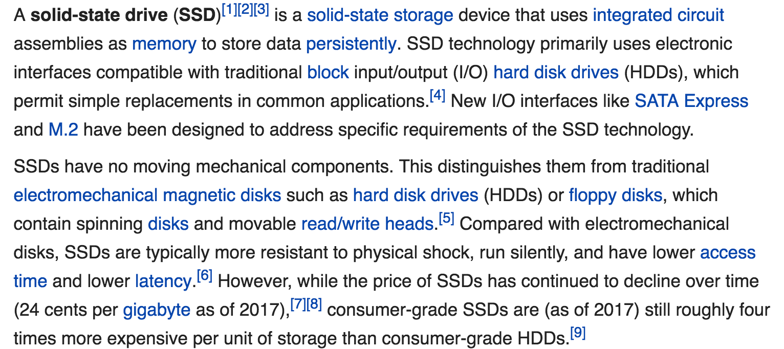
Solid State Drive

Slide 53
SSD Versus HDD (https://www.linux.com/news/ssd-vs-sata-benchmarks-round-2-server-applications)

Slide 54
(Very Old) Comparison
SDD
Is more expensive than HDD per byte of storage.
But,
Getting data to/from memory
from disks
is a major factor in system
Performance.
Price/Performance.
Metric is Ios per second (IOPS)
SDD speed ➔ fewer drives ➔ better cost per IOPS

Slide 55
Disk Scheduling
Solid State Disks are becoming increasingly preferred over HDD.
Faster (no rotation or seek latency).
No moving parts → more reliable.
Even for HDDs
Disk controllers supporting DBs are very sophisticated.
A lot of the placement and scheduling optimization occurs in controller.
Seek and latency considerations are less important to the DB engine, but …
The disk is still very far away.
Some of the optimization are still important.
Especially distributing blocks over multiple disk to achieve
Throughput (IOPS)
Availability
And, efficiently packing possibly variable size tuples into fixed blocks
An example – Elevator Algorithm
Assume
The seek time from track n to m is ABS(n-m).
The I/O request queue is for sectors on tracks 1, 9, 2, 8, 3.
The head is currently on track 5.
Total seek time for FIFO processing
Seek order is 5→1→9→2→8→3
Total seek time is ABS(5-1) + ABS(1-9) + ABS(9-2) + ABS(2-8) + ABS(8-3) = 30
If the head goes all the way up and all the way down, like an elevator,
The seek order 5→8→9→3→2→1
Total seek time is ABS(5-8) + ABS(8-9) + ABS(9-3) + ABS(3-2) + ABS(2-1) = 12
There is a rich body of research and algorithms on optimizing
Blocks on tracks/sectors.
Seek/rotation optimization.

Slide 56
Redundant Array of Independent Disks (RAID)

Slide 57
RAID (https://en.wikipedia.org/wiki/RAID)
“RAID (redundant array of independent disks) is a data storage virtualization technology that combines multiple physical disk drive components into a single logical unit for the purposes of data redundancy, performance improvement, or both. (…)
RAID 0 consists of striping, without mirroring or parity. (…)
RAID 1 consists of data mirroring, without parity or striping. (…)
RAID 2 consists of bit-level striping with dedicated Hamming-code parity. (…)
RAID 3 consists of byte-level striping with dedicated parity. (…)
RAID 4 consists of block-level striping with dedicated parity. (…)
RAID 5 consists of block-level striping with distributed parity. (…)
RAID 6 consists of block-level striping with double distributed parity. (…)
Nested RAID
RAID 0+1: creates two stripes and mirrors them. (…)
RAID 1+0: creates a striped set from a series of mirrored drives. (…)
JBOD RAID N+N: With JBOD (just a bunch of disks), (…)”

Slide 58
RAID (https://en.wikipedia.org/wiki/RAID)
Clearly, we got pretty excited and inventive defining all of these options.
My experience and some independent analysis indicates that the most common levels are
RAID-0: Striping for performance.
RAID-1: Duplication for availability.
RAID-5: Striping and parity availability.
And a lot of environments do this in software using “just a bunch of disks.”
And you still have to deal with, “Don spilled coffee of the disk array controller.”
“RAID (redundant array of independent disks) is a data storage virtualization technology that combines multiple physical disk drive components into a single logical unit for the purposes of data redundancy, performance improvement, or both. (…) ]
RAID 0 consists of striping, without mirroring or parity. (…)
RAID 1 consists of data mirroring, without parity or striping. (…)
RAID 2 consists of bit-level striping with dedicated Hamming-code parity. (…)
RAID 3 consists of byte-level striping with dedicated parity. (…)
RAID 4 consists of block-level striping with dedicated parity. (…)
RAID 5 consists of block-level striping with distributed parity. (…)
RAID 6 consists of block-level striping with double distributed parity. (…)
Nested RAID
RAID 0+1: creates two stripes and mirrors them. (…)
RAID 1+0: creates a striped set from a series of mirrored drives. (…)
JBOD RAID N+N: With JBOD (just a bunch of disks), (…)”

Slide 59
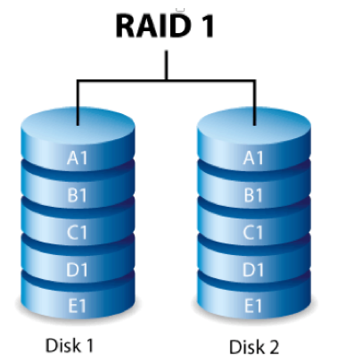
RAID-0 and RAID-1
Two physical disks make one single, logical fast disk
Two physical disks make one single, logical reliable disk
Single “Fast” Disk
Single “Reliable” Disk

Slide 60
RAID 1+0
Stripe
And
Mirror

Slide 61
RAID-5
One Big Logical Disk
Improved performance through parallelism
Rotation/seek
Transfer
Availability uses parity blocks
Suppose I have 4 different data blocks on the logical drive A: A1, A2, A3, A4.
Parity function: Ap = P(A1,A2,A3,A4)
Recovery function: A2=R(Ap,A1,A3,A4), A2 corrupt
During normal operations:
Read processing simply retrieves block.
Write processing of A2 updates A2 and Ap
If an individual disk fails, the RAID
Read
Continues to function for reads on non-missing blocks.
Implements read on missing block by recalculating value.
Write
Updates block and parity block for non-missing blocks.
Computes missing block, and calculates parity based on old and new value.
Over time
“Hot Swap” the failed disk.
Rebuild the missing data from values and parity.
Is actually 5 smaller “logical” disks.
A
B
C
D
E
Logical disk data spread over 5 physical disks.

Slide 62
Very Simple Parity Example
Even-Odd Parity
b[i] is an array of bits (0 or 1)
P(b[i]) =
0 is an even number of bits = 1. {P([0,1,1,0,1,1])= 0
1 if an odd number of bits = 1. {P(0,0,1,0,1,1]= 1
Given an array with one missing bit and the parity bit, I can re-compute the missing bit.
Case 1: [0,?,1,0,1,1] has P=0. There must be an EVENnumber of ones and ?=1.
Case 2: [0,?,1,0,1,1] has P=1. There must be an ODD number of ones and ?=0.
Block Parity applies this to a set of blocks bitwise
A1=[0,1,0,0,1,1]
A2=[1,1,1,0,0,0]
A3=[0,0,0,1,0,1]
Pa=[1,0,1,1,1,0]
➔
If I am missing a block and have the parity block, I can re-compute the missing block bitwise.

Slide 63
Summary
Almost all of this complexity and functionality is hidden from
Database developers.
Database designers and administrators.
Data center, cloud and large scale infrastructure architects
Evaluate and design disk technology and architecture
In combination with other critical technology, e.g.
Networking
Process/compute nodes.
Some customer, optimized, advanced data solutions are a combination of
Custom, optimized database implementation.
Co-designed with underlying infrastructure design.
The disk arrays and controllers do a lot of the low-level functions, but …
The database admin using DB analytics understands the access patterns.
And uses DB tools to choose, optimize and configure storage options.

